Slide 1


AI-driven power electronics design for next-gen lithography
March 31st, 2026
5ARIP10 Team Internship
EE department, Power electronics group
Notes:
Hello everyone, my name is …,
This is and this ..
Our project is about …

Slide 2
What will be covered in this meeting?
Brief introduction to the project and team
The progress made so far on this project
Milestones
Pipeline
Next steps to be taken
Questions

Slide 3
Brief introduction to the project and team
Notes:
Answers what, who and why

Slide 4

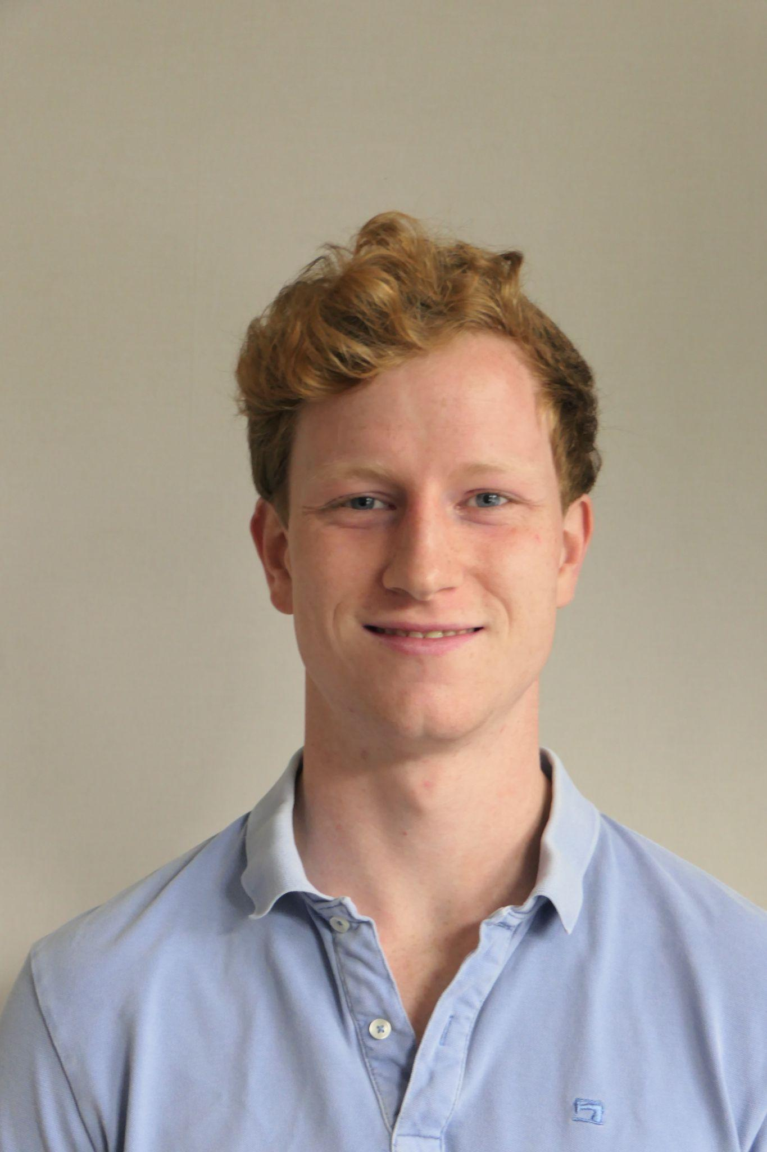


Who are we?
Dong, Zijian,
AI Major
Hogendoorn, Chris,
ME Major
Kumas, Atakan,
CS Major
Shan, Yuhao,
ME Major
Notes:
Everyone (Zijian -> Chris -> Atakan -> Yuhao)

Slide 5
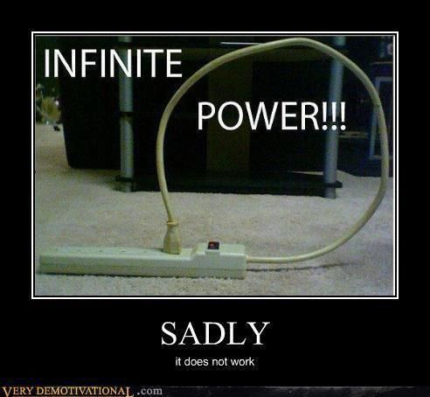
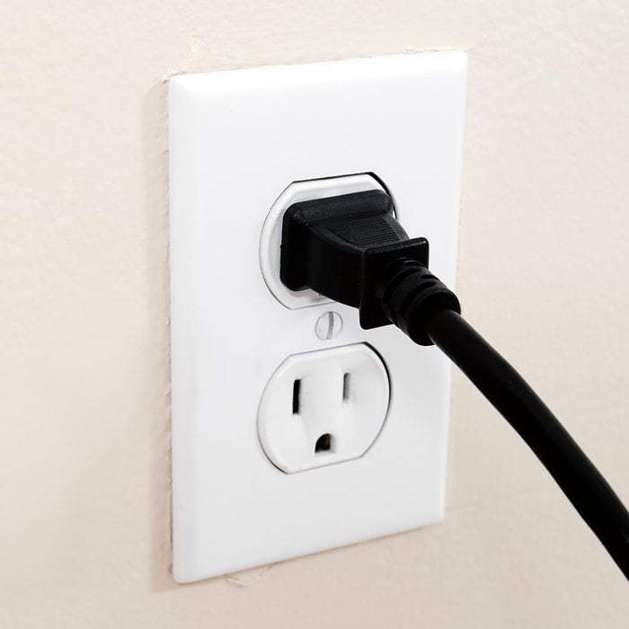


What’s wrong?
What do data centers, electric vehicles, and smartphones have in common?
Answer: They all need power!
How long does it take to design a power electronics system?
Answer: Weeks to months!
Notes:
What do data centers, electric vehicles, and smartphones have in common?
They all rely on efficient power conversion, and Power electronics is the backbone of these systems.
How long does it take to design a power electronics system?
Weeks? Months?

Slide 6
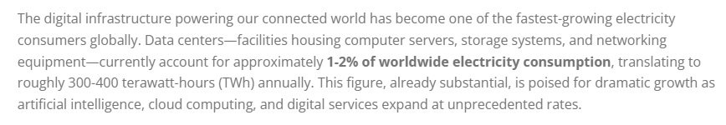
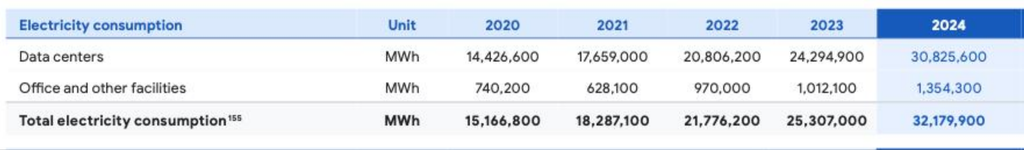
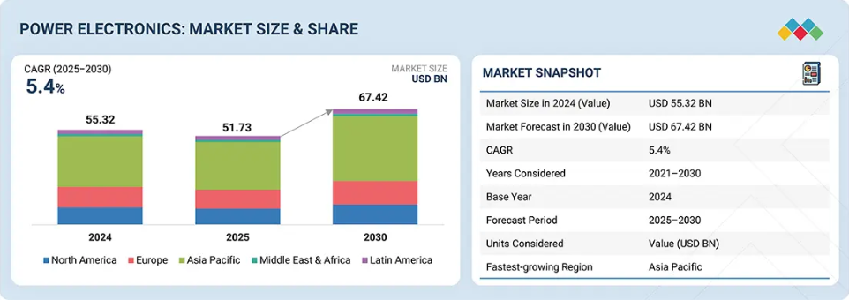
How does this impact companies?
Answer:
Deployment delay
Excess energy consumption
https://www.marketsandmarkets.com/Market-Reports/power-electronics-market-204729766.html
https://sustainability.google/reports/google-2025-environmental-report/
https://www.globalelectricity.org/data-centers-energy-consumption/
https://techcrunch.com/2025/07/01/googles-data-center-energy-use-doubled-in-four-years/
Notes:
Deployment delay:
As these technologies continue to evolve, the demand for better power electronics is rapidly increasing.
Faster innovation cycles mean that companies must design more efficient systems in less time. Otherwise, they risk falling behind.
Energy impact:
Data centers consume ~1–2% of global electricity
(Example: Google data centers consumed 30.8 million MWh in 2024)
Even small efficiency improvements → huge energy and cost savings

Slide 7
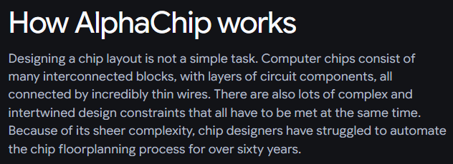
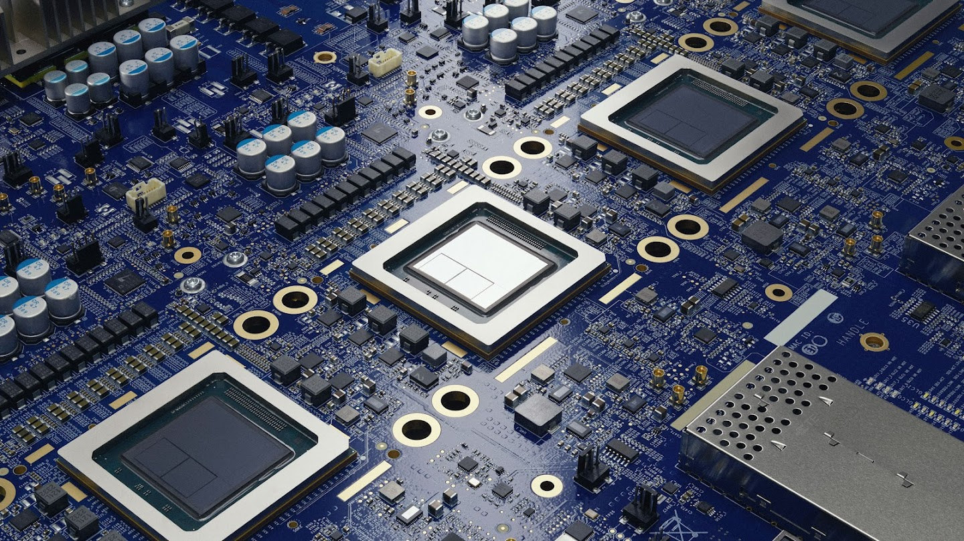
How do we solve this?
Q: What if it the design process could be done in hours?
A: Develop an AI-driven system that is able to explore PE topologies
accelerates circuit design process
swift response to demand
https://deepmind.google/blog/how-alphachip-transformed-computer-chip-design/
Notes:
Chris

Slide 8
Approaches/Directions
LLM-driven topology generation initialized with SFT warm start Generate candidate circuit designs from high-level specifications
Simulation-in-the-loop evaluation Validate and evaluate each design using circuit simulation
RL-based optimization
Learn a policy to iteratively improve topology generation
Notes:
Zijian
Our approach consists of three main components: generation, evaluation, and optimization.
First, we use an LLM to generate candidate circuit topologies from high-level specifications. The model is initialized with a supervised fine-tuning warm start, which enables it to generate reasonable designs from the beginning.
Next, each generated topology is evaluated through validation and circuit simulation. This ensures that the designs are physically valid and get the performance result based on the requirement.
Finally, we use reinforcement learning to update the policy based on simulation feedback. This enables the pipeline to iteratively improve and guide the generation toward better designs.

Slide 9
The progress made so far on this project
Notes:
Answers how

Slide 10
Milestones/Roadmap
Q4
Q3
Literature Review and process research
Model training and tuning
Final report writing
Data generation and simulation processing
Interactive Implementation
Notes:
Atakan
1.
A comprehensive
review of relevant articles will be conducted to identify knowledge
gaps and understand state-of-the-art methods. Based on this analysis,
an appropriate approach to the problem will be chosen.
2.
Based on the
chosen approach, the infrastructure for data generation will be estab-
lished. If the approach calls for a dataset, this will be generated
3.
The model training pipeline will be
implemented. Model performance will be evaluated and improved
through iterative optimization, including hyperparameter tuning,
architectural adjustments, or additional data generation from simula-
tions.
4.
A prototype will be deployed to
demonstrate the model’s performance. This implementation will be
used during the final demonstration.
5.
Comprehensive documentation will be pre-
pared to ensure reproducibility and enable verification of the func-
tional integrity of the developed models.

Slide 11
Milestones/Roadmap
Q4
Q3
Literature Review and process research
Model training and tuning
Final report writing
Data generation and simulation processing
Interactive Implementation

Slide 12
Training pipeline
Supervised fine-tuning
Dataset Expansion
invalid
LLM
Constraint set dataset
Topology generation
Topology validation
Topology simulation
valid
invalid
Reinforcement learning loop
Reward function processing
Notes:
1.
This is our training pipeline, This is how we plan to train our LLM to understand how to output valid netlist give some constraints
2.
A constraint set, in the form of a json will be delivered as an input to a larger LLM that generates a an adjustable number of topologies in the form of a SPICE netlist (.net).
These netlists go through a validation process to classify hallucinations and actual working topologies.
3.
The validation algorithm classifies topologies either as valid or invalid based on pre-simulation hard constraints
(e.g. syntax, floating nodes, short circuits, …).
Valid topologies are simulated through LTSpice. Invalid topologies are augmented to a netlist validation class dataset.
The validation algorithm may not work perfectly, thus the simulation process may fail for false positive cases (invalid classified as valid).
4.
Reward Function
This is how we plan to distinguish between good topologies and bad topologies.
Based on the simulation results we calculate a fitness score based on the Hard constraints, an Area estimate and the efficiency.
This value is then sent to the reinforcement learning part
Reinforcement learning Part:
Reinforcement learning serves as the optimization layer in our pipeline.
We first aggregate reward signals from simulation, including efficiency, and constraints.
These signals are then used to update the policy, using batched learning for stability and efficiency.
The updated policy is fed back to guide future topology generation.
This creates a closed loop that allows the system to continuously improve over time.
5.
SFT stands for Supervised Fine-Tuning
All generated netlists, including both valid and invalid ones, are added to a dataset.
Using this dataset, we perform supervised fine-tuning so that the LLM can learn to distinguish between valid and invalid topologies.
This helps the model better understand what a feasible circuit looks like before reinforcement learning.

Slide 13
Supervised fine-tuning
Dataset Expansion
invalid
LLM
Constraint set dataset
Topology generation
Topology validation
Topology simulation
valid
invalid
Reinforcement learning loop
Reward function processing
A constraint set, in the form of a json will be delivered as an input to a LLM that generates a an adjustable number of topologies in the form of a SPICE netlist (.net).
These netlists go through a validation process to classify hallucinations and actual working topologies.
Notes:
Yuhao
A constraint set, in the form of a json will be delivered as an input to a larger LLM that generates a an adjustable number of topologies in the form of a SPICE netlist (.net).
These netlists go through a validation process to classify hallucinations and actual working topologies.

Slide 14
Supervised fine-tuning
Dataset Expansion
invalid
LLM
Constraint set dataset
Topology generation
Topology validation
Topology simulation
valid
invalid
Reinforcement learning loop
Reward function processing
Valid or invalid based on pre-simulation hard constraints:
syntax, floating nodes, short circuits, etc
Valid topologies are simulated through LTSpice. Invalid topologies are augmented to a netlist validation class dataset.
The validation algorithm may not work perfectly, thus the simulation process may fail for false positive cases (invalid classified as valid).
Notes:
Atakan
The validation algorithm classifies topologies either as valid or invalid based on pre-simulation hard constraints
(e.g. syntax, floating nodes, short circuits, …).
Valid topologies are simulated through LTSpice. Invalid topologies are augmented to a netlist validation class dataset.
The validation algorithm may not work perfectly, thus the simulation process may fail for false positive cases (invalid classified as valid).

Slide 15
Supervised fine-tuning
Dataset Expansion
invalid
LLM
Constraint set dataset
Topology generation
Topology validation
Topology simulation
valid
invalid
Reinforcement learning loop
Reward function processing
Reward function based on:
Hard constraints
Area estimate
Efficiency
Reinforcement learning
Aggregate reward signals
Policy update via batched learning
Guide future topology generation
Notes:
Chris: Reward Function
This is how we plan to distinguish between good topologies and bad topologies.
Based on the simulation results we calculate a fitness score based on the Hard constraints, an Area estimate and the efficiency.
This value is then sent to the reinforcement learning part
Zijian: Reinforcement learning Part:
Reinforcement learning serves as the optimization layer in our pipeline.
We first aggregate reward signals from simulation, including efficiency, and constraints.
These signals are then used to update the policy, using batched learning for stability and efficiency.
The updated policy is fed back to guide future topology generation.
This creates a closed loop that allows the system to continuously improve over time.

Slide 16
Supervised fine-tuning
Dataset Expansion
invalid
LLM
Constraint set dataset
Topology generation
Topology validation
Topology simulation
valid
invalid
Reinforcement learning loop
Reward function processing
All netlists are added to the dataset.
Using this dataset of netlists with valid and invalid labels we finetune the LLM to recognise what a valid topology looks like.
This is called Supervised Fine Tuning (SFT) Warm start.
Notes:
Zijian
SFT stands for Supervised Fine-Tuning
All generated netlists, including both valid and invalid ones, are added to a dataset.
Using this dataset, we perform supervised fine-tuning so that the LLM can learn to distinguish between valid and invalid topologies.
This helps the model better understand what a feasible circuit looks like before reinforcement learning.

Slide 17
Testing pipeline
Fine-tuned LLM
User input
Topology generation
Model response
Input: Accept plain-text design specification from user
Performance requirements
Constraints
Bogus prompts (?)
Output: Generates a set of distinct, structural, optimal and reliable topologies that meet the specifications of the user.
Notes:
Atakan

Slide 18
The next steps to be taken
Notes:
Answers so what?

Slide 19
Next Steps
System Integration
Merge codebases and validate the end-to-end framework.
SFT Data Preparation
Generate and curate datasets for Supervised Fine-Tuning.
Training & Evaluation
Execute model training and assess topology generation performance.
Iterative Refinement
Fine-tune parameters based on test metrics to iterate model versions.
Adaptive LoRA Routing
Train constraint-specific LoRAs with a dynamic routing mechanism for scenario adaptation.
Notes:
Yuhao

Slide 20
References
AI-Driven Integrated Circuit Design: A Survey of Techniques, Challenges, and Opportunities, IEEE： https://ieeexplore.ieee.org/stamp/stamp.jsp?tp=&arnumber=11153923
Automated Design of Analog Circuits Using Reinforcement Learning： https://ieeexplore.ieee.org/stamp/stamp.jsp?tp=&arnumber=9576505
Automatic Power Converter Design via Reinforcement Learning (Fan et al., ICCAD 2021)：https://shunzh.github.io/pdfs/fan-iccad-2021.pdf
An Overview of Reinforcement Learning for Power Electronic Converters (2025):
https://www.sciencedirect.com/science/article/pii/S136403212501264X
AUTOCIRCUIT-RL: Reinforcement Learning-Driven LLM for Automated Circuit Topology Generation (IBM Research, ICML 2025):
https://researchwith.njit.edu/en/publications/from-specification-to-topology-automatic-power-converter-design-v/
Revolutionizing Power Electronics Design through Large Language Models (ScienceDirect, 2025):
https://www.sciencedirect.com/science/article/pii/S0045790625001910
Graph Neural Networks for Topology Recognition of AMS Integrated Circuits (Polito thesis):
https://webthesis.biblio.polito.it/28628/1/tesi.pdf
Notes:
Efficiency
Cost
Density

Slide 21
What would you do differently in our approach (e.g. the training pipeline)?
Our questions
Imagine that this project is completed, along with the solution, do you see any problems it might still introduce afterward?
As you can see we are still discussing of using a single LLM for certain tasks. Would a mixture of agents strategy be a better idea or not?

Slide 22
Feedback
Regarding the Model Selection, Could you validate why you choose transformer LLM, rather than other types such as Graphical Model.
The scope of the project is a bit unclear, especially for people without relevant background knowledge.
Also need more logical connection between the Energy Consumption case(page 2) and our project, why our project can alleviate this problem.
The motivation of <Topology Validation> is not Strong enough.

Slide 23
Zijian dong
What is your individual contribution to the project so far?
How is your initial planning affected by now?
What do you expect to achieve?
I worked with my teammates continuously on the shared tasks, such as planning, brainstorming and research, pipeline design, etc.
I take care of the minutes of the meating for further reference, and I personally focuse on the implementation of the Reinforcement learning loop, which is part of the whole pipeline.
I feel the current workflow is in line with the initial plan.
I expect the whole project can be completely functional, while everyone could gain more experience in products development& domian knowledges, communication skills.

Slide 24
Atakan Kumas
What is your individual contribution to the project so far?
I worked on parts of the project plan. I was also responsible for researching simulation engines, learning methods and implementing the simulation process for the training pipeline.
How is your initial planning affected by now?
At first, It felt like a dilemma to choose a direction together with the team, but after further research and discussion, we we’re able to build a consensus. For the rest, I find it going according to plan.
What do you expect to achieve?
I expect a result that can please everyone in the team and that can reflect our hard work for achieving it. At the end of this internship, I wish to have gained a lot of experience that I can apply in later projects and my future career.

Slide 25
Chris hogendoorn
What is your individual contribution to the project so far?
How is your initial planning affected by now?
What do you expect to achieve?

Slide 26
Yuhao Shan
What is your individual contribution to the project so far?
How is your initial planning affected by now?
What do you expect to achieve?
I did some research for our project with the approach and worked on the implementation of the LLM interface.
At first I just wanted to use LLM as a semantic converter and train a GNN model as Netlist generator. And after communication, we chose to use a trained LLM to generate topologies.
I expect to achieve our requirements of the project successfully and get experience on how to develop a project with LLM.

Slide 27






Solution:
I want the heart to look like this …
This is ASML guy, he is tired of designing hearts for the machine 💔. It takes too much time! His boss will get angry if market deadlines aren’t met.
Thanks to efficient AI-generated heart structures, machines work optimally. ASML guy is happy and boss is also happy. With better chips, cancer research, stopping climate change etc. will be made more accessible.
Notes:
Beginning
Computers have chips, they work like our brain doing all the thinking and decision making
Unlike brains, chips can be manufactured and reproduced
Once upon a time, a company called ASML, decided to make machines that can build these little tiny reproducible brains. To make these machines reliable, efficient and swift, we need to make sure its circuits are properly set up. You can look at circuits as organs in your body that work together to ensure your body functions properly. Coming up with a structure for these circuits takes too much time. We are interested in one particular organ, which is the heart. In the machine’s analogy, this is what we call power electronic circuits providing power to the rest of the machine.
Middle
But there is a problem, The designing of the power electronics for different systems is difficult and time consuming. This makes the development of new machines slower. Bad and slow machines means missed opportunities and rivals may take over.
End But a solution is in sight! ASML has been interested in integrating AI in their business to solve problems like this one. Hence, we aim to develop an AI-powered model that is able to process what the company specifically needs and provides structures for these hearts. We need good circuits, because they power the world consequently ensuring better chips which would improve mankind. Allowing cancer research, stopping climate change and so on, all these goals will be sped up or even made possible with new better chips.
Circuits: They power the world, having better chips would improve mankind. Allowing cancer research, stopping climate change, all these goals will be sped up or even made possible with new better chips
Why: Power converter designs are time time consuming, causing the design process to take longer. This makes the development of new machines slower.
Goal: Create an AI model that could give power converter circuits given some constraints.

Slide 28
Process pipeline
Supervised fine-tuning
Dataset augmentation
invalid
User input
Instruction processing
Topology generation
Topology validation
Topology simulation
valid
invalid
Reinforcement learning loop
Reward function processing

